Slide 1
بسم الله الرحمن الرحیم

Slide 2
Our Presentation About Timetable designing
Requirements
University
Faculty
Departments (Branches)
Timetable
Classes
Teachers
Subjects
Period time
Days
Semester

Slide 3
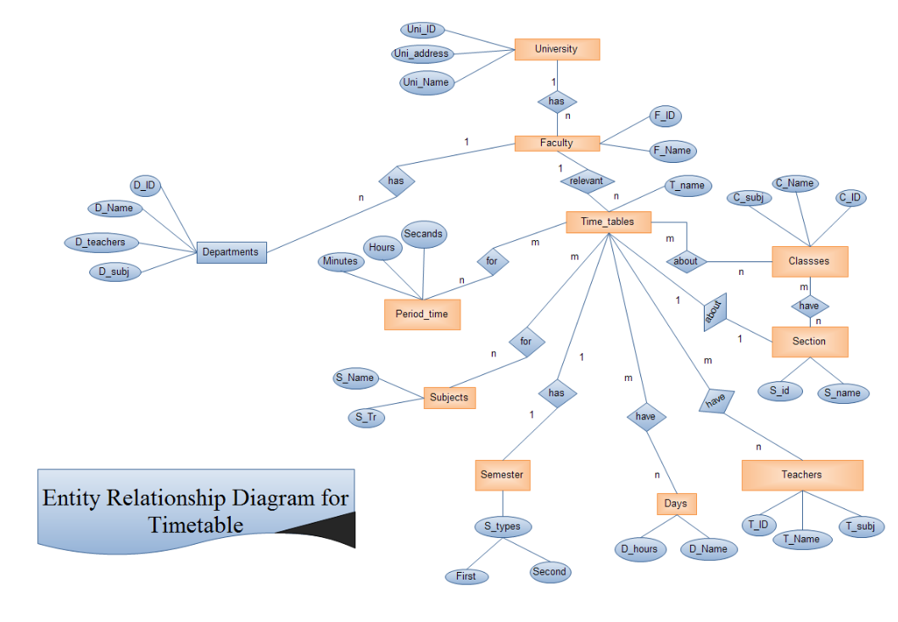

Slide 4
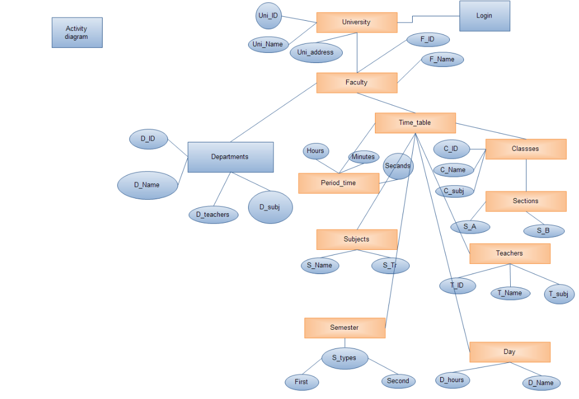
Activity diagram

Slide 5
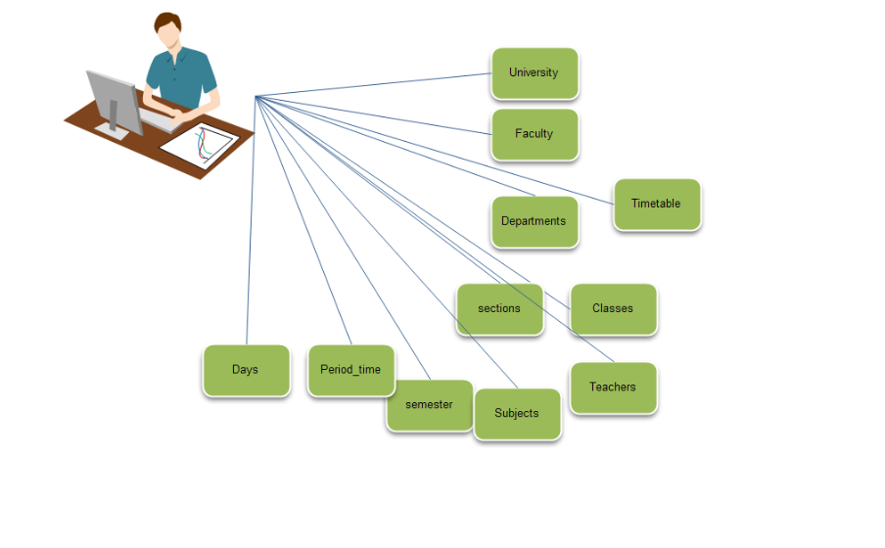
Use case diagram

Slide 6
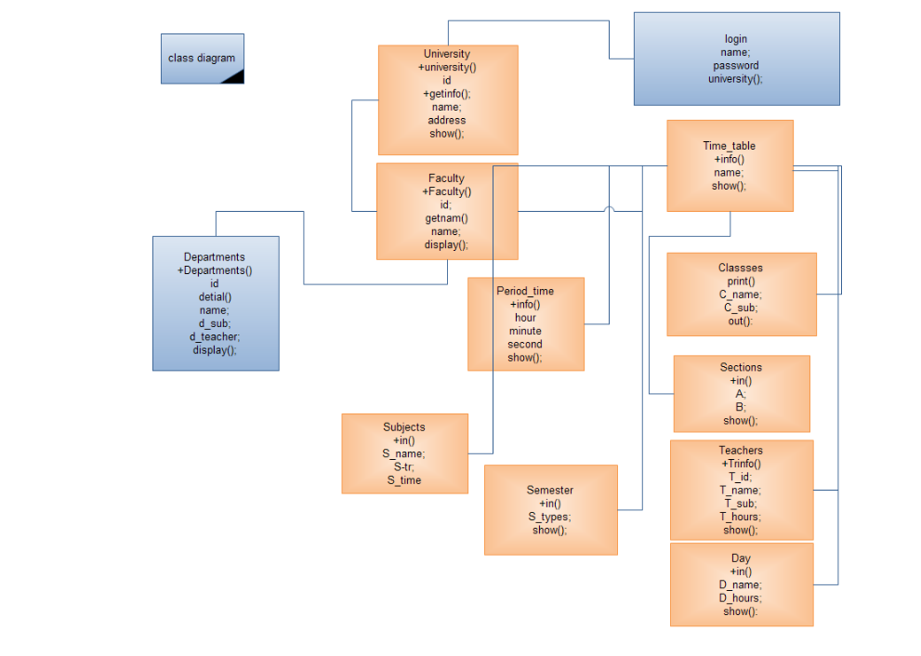

Slide 7
Thanks
Designing team
Baryal Besmill
Khalid Durrani

